Slide 1
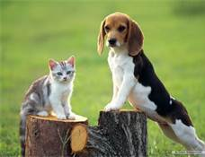
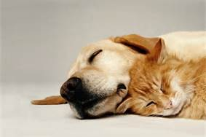
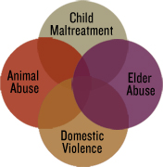
The Link between Animal Abuse and Domestic Violence
Notes:
Introduce selves and we are with LEVI We appreciate being asked here today to speak to you about the LINK. Discuss LEVI

Slide 2

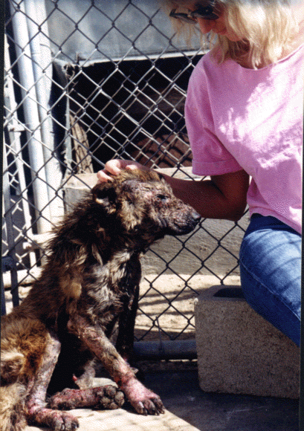
More American households have pets than have children. We spend more money on pet food than on baby food. There are more dogs in the U.S. than people in most countries in Europe - and more cats than dogs.
A child growing up in the U.S. is more likely to have a pet than a live-at-home father.

Slide 3
Pets live most frequently in homes with children: 64.1% of homes with children under age 6, and 74.8% of homes with children over age 6, have pets. The woman is the primary caregiver in 72.8% of pet-owning households.
Battered women have been known to live in their cars with their pets for as long as four months until an opening was available at a pet-friendly safe house.

Slide 4
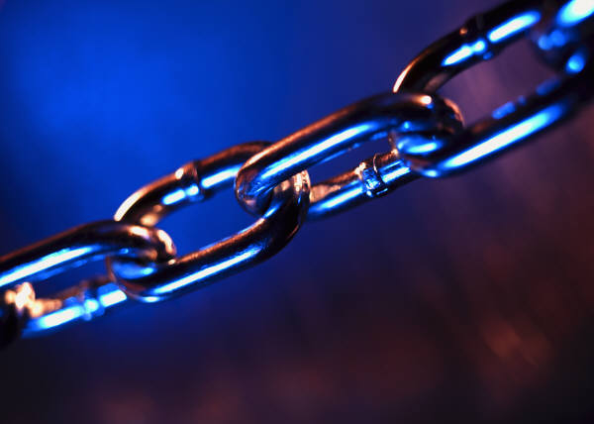
The “Link”
Over the past 30 years, researchers and professionals in a variety of human services and animal welfare disciplines have established significant correlations between animal abuse, child abuse and neglect, domestic violence, elder abuse and other forms of violence.

Slide 5
The “Link” continued
Mistreating animals is no longer seen as an isolated incident that can be ignored: it is often an indicator or predictor crime and a “red flag” warning sign that other family members in the household may not be safe. We call this species-spanning interconnectedness of different forms of violence “The Link.”

Slide 6
What does this mean?
When animals are abused, people are at risk…..
When people are abused, animals are at risk…..

Slide 7
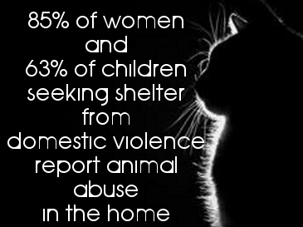

Sad Facts

Slide 8
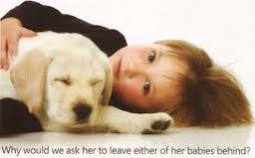

25%-48% of battered women delay leaving an abusive situation for fear of what will happen to her pet if left behind.
Notes:
Women and children are sometimes intimidated into silence about sexual or physical abuses through threats. In a study done, it was found that 1 in 4 women reported the concern for their pets had kept them from coming to a shelter sooner

Slide 9
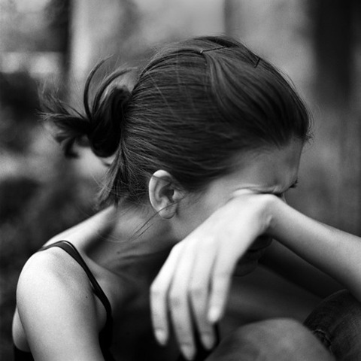
Victims would rather stay in an abusive situation than to leave the pet with the abuser.
Notes:
They tolerated the abuse rather than leaving their pet with the abuser. Pets are hurt and killed to punish the people in the family for something they have done.
The abuser has all the power and power is everything.

Slide 10
Why do Abusers Batter Animals?
To demonstrate and confirm power and control over their family
To isolate the victim and children
To enforce submission
To perpetuate an environment of fear
To prevent the victim from leaving or coerce her to return
To punish victim for leaving or showing independence
To eliminate competition for attention
Notes:
All forms of oppression are maintained through violence.

Slide 11
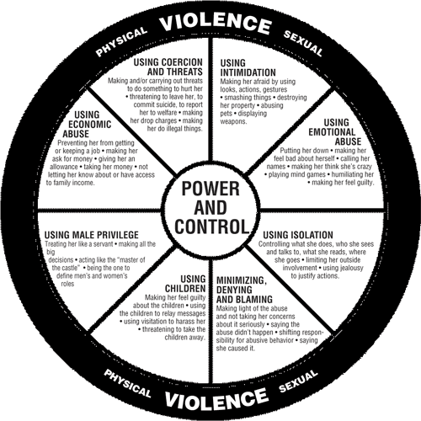

Slide 12
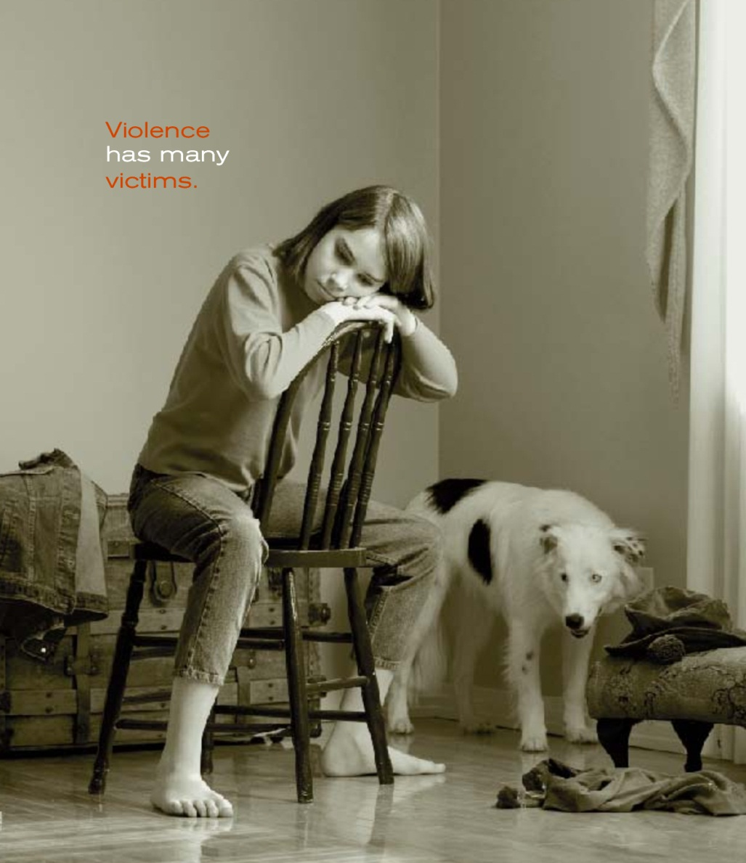
Abusers create terror by generating fear as a tool to control others.
Through their violence towards an animal they announce “You may be next.”
Notes:
Angela Browne writes that the killing of a family pet often removes a battered woman’s last hope. These killings often seemed like a representation of their own deaths.
Anne Ganley, a psychologist who has pioneered victim-based counseling for batterers observes the offender and the victim do not always identify the destruction of property and pets as part of the battering yet it is. The offender’s purpose in destroying is the same as his physically attacking his partner. He simply attacks something else to accomplish his battering. The abuser may not be hitting the victim but it often has the same psychological impact on the victim as a physical attack and it does cause injury or death to the animal.
By harming an animal, the abuser accomplishes several goals.
They create terror by generating fear.

Slide 13
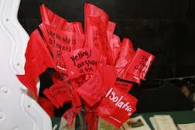
Animal cruelty should serve as a warning that the members of the family may also be in an abusive situation or that the potential for future violent behavior towards humans exists.
Notes:
Animal cruelty should serve as a warning that the members of the family may also be in an abusive situation or that the potential for future violent behavior towards humans exists.

Slide 14
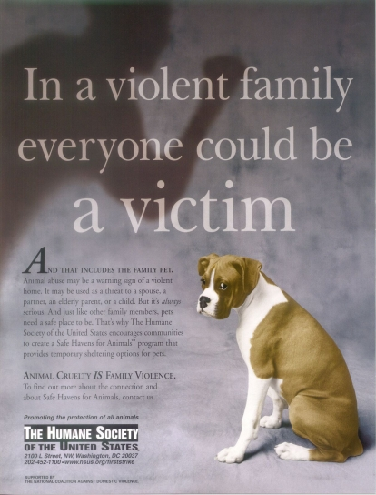
In some cases, the animal is the last victim in a chain of abuse that filters down from the strongest family member to the weakest.
Notes:
Abused children act out aggression and frustration on the pet they perceive as even more vulnerable than themselves. The animals are the last link in a chain of abuse that goes from strongest to weakest.
In a study of 57 families being treated for incidents of child abuse, 88% of these families also abused animals
In 2/3rds of the cases, it was the abusive parent who killed or injured the animal to control the child
And in 1/3rd of the cases, the child had abused the animal, using it as a scapegoat for their anger.

Slide 15
What is the #1 Public Safety Issue in Longmont and in this Neighborhood?
DOMESTIC VIOLENCE
Domestic violence and dating violence
injure more people than all other
crimes combined!
Many crimes are domestic violence related.
Notes:
Longmont averages 1-2 DV incidents (many resulting in arrests) a day -

Slide 16

Domestic Violence in Longmont
656 cases in 2011
1,300 calls for service
29% of those involved ages 18-24 (2010)
72% of defendants were male
2 Detectives are assigned to manage these cases full-time

Slide 17
What is Domestic Violence?
Domestic violence includes actual or threatened physical, sexual, psychological, or emotional abuse by a current or past spouse, boyfriend, girlfriend or date.
Victims of domestic violence are women, men, people who are dating, senior citizens, and LGBT relationships.
Dating violence is domestic violence!
Notes:
Emphasize current or past relationship. Is not limited to same sex. Does not have to have sex, but must be “intimate” to be considered domestic violence. 75% of victims in Boulder County are female while 25 are male. Predominant aggressor law (person who “eggs on” is arrested) - adds to the number of frustrated victims that end up being tagged as offenders (ie story about woman throwing shoe at her husband – she was arrested because they couldn’t find any probably cause that he physically hit her, and she threw her shoe at his head – therefore she was arrested).

Slide 18
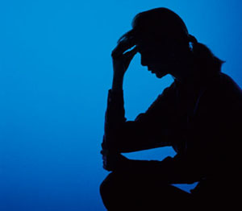
Types of Domestic Violence
Physical
Emotional
Sexual
Verbal
Notes:
ELECTRONIC/TECHNOLOGICAL/STALKING
There are 4 main types of domestic violence
Physical – hitting, slapping, punching, grabbing,
Emotional - Threats, silent treatment, lying, spreading rumors
Sexual - Crossing boundaries, taking advantage
Verbal - Name-calling, put downs
Other abusive behaviors:
One person is always making decisions and not listening to other person’s ideas.
Always following you around, lots of texting or calling, showing up when you don’t expect it (harrassment, stalking)
Hurting a pet to get back at someone.
Not letting you be with friends or family, or making you feel bad if you do
Economic abuse – controlling all the $$, not letting you have a job, allowances, etc.
It is against the law for somebody to: Hurt you, Try to hurt you, Force you to have sex, Threaten you with weapons, Harass you on the telephone or through the mail, Stalk you or Destroy things that belong to you.

Slide 19
Power and Control
When somebody abuses, they DO NOT
have a problem with anger …
They want POWER and CONTROL!
Violent and abusive phase
Cycle of Violence
Honeymoon phase
Tension-building phase
Notes:
When a couple is in an unhealthy relationship, it happens over and over again to keep control and power! If you aren’t sure, just take 10 seconds to think about why that person just said or did that thing – was it to have POWER and CONTROL? If so, it’s ABUSE and it’s UNHEALTHY!
CYCLE OF VIOLENCE: Tension building phase, violent and abusive phase, honeymoon phase
Everybody experiences ups and downs in their relationships. There are times when everything is wonderful and fun. There are other times when you aren’t agreeing on something or you are angry with each other. People in healthy relationships take time out to talk and to resolve the situation in a way that is respectful.
But, in an unhealthy relationship, the controlling person will verbally insult, physically humiliate or sexually assault the other. After the blowup, the abuser will apologize for what happened and promise never to act that way again. The victim wants to believe this and welcomes back the partner. Because the abuser’s apologies are ways of manipulating the victim into staying into the relationship and not sincere efforts to change, in time, the tension will begin to grow and the cycle will repeat itself.

Slide 20
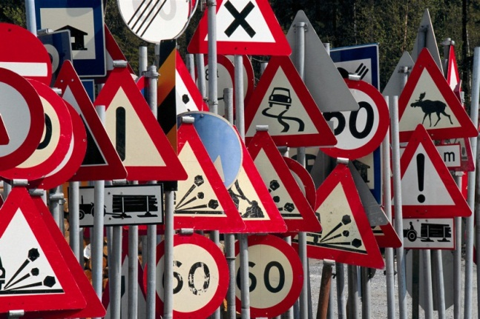
Domestic Violence Warning Signs
Jealousy | Controlling Behaviors | Quick involvement in relationship | Unfair Expectations
Isolation | Blames others for problems and feelings | Harassment or stalking | Cruelty to animals or children
Verbal abuse | Rigid sex roles | Jekyll & Hyde personality | Threats of Violence
Physical violence | Breaking things | Intimidation
Recognize
Notes:
Jealousy - Is suspicious about everyone with whom you speak, wants to be with you constantly, tries to turn you against your parents. Frequently follows you, makes persistent and unwanted contacts. Leaves messages intended to show you that you are being watched.
Controlling behaviors - Tries to decide what you do and with whom you spent time, gives orders and expects you to follow them, hides controlling behavior behind pretending to be concerned about your safety. Makes all of the decisions in the relationship, uses phrases like “I’ll show so and so who is the boss” or “I just made it clear who runs the show” to justify abusive behavior. Intimidation by destroying personal belongings, speeds or drives recklessly to scare you, uses a loud or intimidating tone of voice, calls repeatedly to check up on you or harass you.
Quick Involvement - Pressures you to go steady right away, claims love at first sight.
Unfair Expectations - Expects you to put up with quickly-changing moods, expects you to be available all of the time, expects you to forgive and forget immediately.
Isolation - Discourages you from spending time with friends, puts down everyone you know including your family and friends. forbids you to talk with your friends, accuses you of cheating, decides the social and school activities in which you will participate, control what clothes you wear, discredits your parents advice, encourages you to turn against your parents.
Blames Others for Problems and Feelings - If there are problems at school or at work it is always someone else's fault. Blames you for everything that goes wrong in the relationship.
Overly sensitive - is easily insulted, see everything as a personal attack, blows things out of proportion.
Force Used in Sex - Asks you to do things you do not want to do, uses sulking or anger to manipulate you into giving in.
Verbal Abuse - Puts you down in front of other friends, makes you feel stupid. Emotional abuse: puts you down or makes you feel bad about yourself, breaks dates or cancels plans without any reason, embarrasses you in front of family and friends, uses words or tells jokes that humiliate you, uses drugs and alcohol to excuse abusive behavior, changes moods abruptly.
Rigid Sex Roles - Believes males and females must act certain ways and do certain things.
History of Battering - Was violent/abusive to partners in previous relationships.
Threats of Violence - Breaks or strikes objects near you in order to frighten you. threatens to hurt you if you decide to break up, threatens to commit suicide when you talk of breaking up, threatens to hurt others who talk to you, threatens your family and friends.
Force Used During an Argument - Yells and curses during an argument in order to scare you into agreeing.

Slide 21
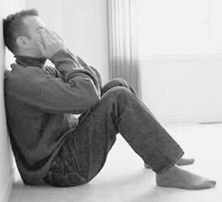
Why do abusers abuse?
Low self-esteem | May present dual personality | Traditional roles - supremacy
Uses the excuse of “keeping the family together” | Suffers from past issues such as child abuse, neglect or witnessing abuse | Uses violence to deal with feelings
 | Pathologically jealous and intrusive into partner’s life | Blame their actions on their partner or others

Slide 22
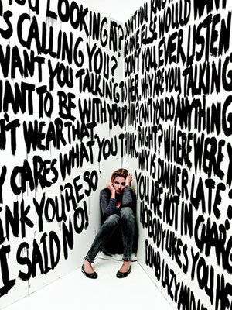
Why can’t victims leave?
Low self-esteem | Economic dependence | Keeping the family together
Religious beliefs | Promises of Change | Emotional dependence
Fear of insanity | Isolation | Perception of no place to go
Learned behavior – GUILT | Societal attitudes / traditional roles | FEAR!
Notes:
Offenders tend to be highly manipulative.
Low Self-Esteem: cutting her down, telling her she is fat, chipping away at sense of self worth. By the time the physical violence begins self-esteem is seriously damaged. When you do not value yourself it is more likely that you will accept and put up with the physical abuse. Once self-esteem is broken down it can be even harder for a person to leave a relationship.
Victim’s self-esteem is extremely low DURING THE RELATIONSHIP. Many victims were independent and had normal self-esteem and confidence before the relationship, and after the relationship, but the offender has taken this away during the relationship.
Economic dependence: The offender often times is the sole provider. Often times they won’t allow the victim to work, and they make her feel that she doesn’t have the skills to bring in $ anyway. She doesn’t have access to $, so she is completely dependent on the offender financially.
Keeping the family together: Doesn’t wish to create a “broken home”.
Religious beliefs: Many victims and offenders believe that it is wrong to break up a marriage, no matter what the circumstances.
Promises of Change: Offenders are highly manipulative, so it is easy to believe he really wants to change and right the situation.
Emotional dependence: Intimate relationship, and DV occurs over time, so emotional dependence occurs.
Fear of Insanity: The offender often times makes the victim feel crazy. He manipulates conversations and situations to make her feel like she is not sane.
Isolation: Offender has taken away all the victim’s prior support from family and friends. If victim chooses to leave, they would feel all alone in doing so.
No place to go: This is not the case, victims can stay in a shelter if in danger. However, victim is probably thinking more long-term. What do I do in the long run?
Learned behavior – guilt: Victim has been put down for so long, they start to believe that they are really causing the abusive situation – they are pushing all the wrong buttons, etc. That if they change, the abuse will just go away.
Societal attitudes/traditional roles: Women should be controlled by men. Men are the head of the house.
FEAR: Fear he will get more angry after she leaves, and will come after her. Lethality is greater 3 months after victim leaves. He wants that power and control back!

Slide 23
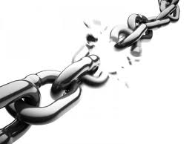
91% of all victims report having talked with family, friends, relatives or co-workers about the violence
83% of all victims who sought help did so because someone on the outside asked what was going on in the relationship.
ASK!
Respond
Notes:
The key here is that DV is not an individual or police issue – it is a community issue. We need to teach people how to respond and how to help.
People are more likely to open up about pets than themselves.

Slide 24
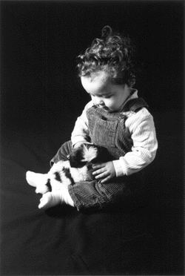
Children & Animal Cruelty
Children are not born knowing how to treat animals.
They learn their humane attitudes from the social values portrayed by parents and other influential adults.
Notes:
Abuse of animals can start at an early age. Low self-esteem and peer pressure can lead kids to do things they normally would not do.
Children learn humane attitudes from those around them, parents and other influential adults. They aren’t born knowing how to treat an animal.
Children who haven’t learned effective problem-solving skills may vent their aggression and frustration on animals.
Some older children may abuse animals to amuse themselves or impress or shock others.

Slide 25
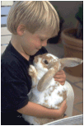
Children who view animals as objects instead of living beings may not make the connection that animals can suffer from pain too.
Notes:
Children don’t always understand that animals can feel pain too. If they see the animals in the family as objects instead of living beings it becomes harder to understand. They may be being abused themselves and then release their anger toward the abuser on the animals in the family.

Slide 26

Children who abuse animals are usually abused themselves and stand a significant risk of growing up to be abusers.
Notes:
Curiousity about an animals body is normal, but if that child demonstrates sexually behavior with an animal it could mean that they are being sexually abused.

Slide 27
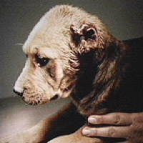
“One of the most dangerous things that can happen to a child is to kill or torture an animal and get away with it.”
- Margaret Mead
Notes:
Noted anthropologist, Margaret Mead once said that one of the most dangerous things that can happen to a child is to kill or torture an animal and get away with it.

Slide 28
The final link…child maltreatment
“Abusing an animal is a way for a human to find power/joy/fulfillment through the torture of a victim they know cannot defend itself.
“Child abuse is a way for a human to find power/joy/fulfillment through the torture of a victim they know cannot defend themselves.”
DO YOU SEE THE PATTERN HERE?
Notes:
STORIES

Slide 29
Child Abuse
Co-occurs with domestic violence in at least 50% of cases and more recently is estimated at 80%.
Is automatically charged if a child is present during a DV incident (39% of formal Longmont cases in 2010).
Often includes sexual assault of the child.
Perpetuates the cycle…exposure to violence in the home is the strongest risk factor for transmitting violent behavior to next generation.
Notes:
Children in homes where domestic violence occurs are physically abused at a rate 1500% higher than the national average. (Ford 1991)

Slide 30
Colorado Domestic Violence Law
CO ST § 18-6-800.3; C. R. S. A. § 18-6-800.3
"Domestic Violence" also includes any other crime against a person, or against property, including an animal, or any municipal ordinance violation against a person, or against property, including an animal.

Slide 31
Colorado Law passed in 2010 Regarding Protection Orders
Also, a protection order prohibits the abuser from threatening, taking, transferring, concealing or harming an animal owned by the protected person. *
* See Colo. Rev. Stat. §13-14-101(2.4)(a)

Slide 32
Mandatory Reporting
Section 19-3-304. Persons required to report child abuse or neglect.
“Any veterinarian who has reasonable cause to know or suspect that a child has been subjected to abuse or neglect or who has observed the child being subjected to circumstances or conditions which would reasonably result in abuse or neglect shall immediately report or cause a report to be made of such fact to the county department or local law enforcement agency.”
Respond

Slide 33
Outlets for Support
Safe Shelter of St.Vrain Valley
  Counseling, advocacy, safety planning, support, protection order assistance
  24 hour crisis line: 303-772-4422
LEVI (Longmont Ending Violence Initiative)
  Non-emergency info and referrals: 303-774-4534
Longmont Police Department
  Emergency, dial 911
  Non-emergency: 303-651-8555
Boulder County Social Services: 303-441-1000
National Domestic Violence Hotline
  1-800-799-7233
Refer

Slide 34

Longmont Ending Violence Initiative
(LEVI)
LEVI provides the following non-emergency resources:
Prevention/Education
Empower the community to end domestic violence through educational and informative presentations, training, awareness campaigns & events.
Public Information
Heighten community awareness and action, as well as change public opinion and social behavior toward domestic violence.
Access/Referrals
Provide referrals and easy access to local resources for
domestic violence victims and their families.

Slide 35

Safe Shelter of St.Vrain Valley
Bilingual 24-hour crisis line
Shelter, counseling and advocacy for victims and their families
Outreach Center for ongoing counseling, support, safety planning and legal advocacy.
Youth services including TERA (Teens Ending Relationship Abuse) peer education group
All services confidential and free of judgment

Slide 36

Longmont Police Department
Animal Control Officers:
  Robin Breffle
  Tammy Deitz
  Allison Meyer
  Diane Milford
Longmont Police Department Domestic Violence Detectives:
  Detectives Sandie Esters and Mark Deaton

Slide 37

Longmont Humane Society
Shelter, adoption
Clinic
Training classes
Public outreach
Advocacy
Thrift store
www.longmonthumane.org
303-772-1232

Slide 38

Contact Information
Jackie List, Executive Director – Safe Shelter of St. Vrain Valley
jackie@safeshelterofstvrain.org, 303-772-0432
Trish Wood/Kim Heard – LEVI Project Coordinators
levi@ci.longmont.co.us, 303-774-4534
Robin Breffle-Longmont Police Department Animal Control
robin.breffle@ci.longmont.co.us, 303-774-4300 x4086
Dr. Sue Muench – CVMA/CACP Liaison
dr.muench@comcast.net

